Slide 1


Pitch Deck
PRESENTATION
Prihub: A Full Stack Platform for Individuals with Cognitive Disabilities
KETAN CHOWDHURY – 22EARCS082
PELHEIBA KHANGEBAM – 22EARCS121
Name of Mentor: Dr. Vishal Shrivastava
PRANJAL KHANDELWAL – 22EARCS125
VISHAKHA TOMAR – 22EARCS185

Slide 2
The Challenges
01
02
03
04
Problem 1
Problem 2
Problem 3
Problem 4
Individuals with cognitive disabilities face barriers in digital access
Complex interfaces, unclear language, and inconsistent layouts
are major issues
Existing platforms are not tailored to their needs
Lack of reliable and guided support
online

Slide 3



Solution 1
A full-stack accessible platform
01
Solution 2
Designed for users with cognitive disabilities
02
Solution 3
Offers:
Easy-to-read content
Step-by-step guidance
Visual aids
Consistent UI/UX
AI-powered chatbot for real-time help
03
PRIHUB

Slide 4
Key
Features
Feature 1
Simple and intuitive User Interface, Consistent layout and navigation
Feature 2
Screen reader compatibility ensures that users with visual impairments or cognitive challenges
Feature 3
AI chatbot for real-time assistance with
Answer questions
Guide through tasks
Provide reminders
Simplify technical content
Feature 4
Visual learning support, Secure Firebase Authentication
Feature 5
Step-by-step instructional guides Break complex tasks
into manageable steps, Offer real-time feedback or hints

Slide 5
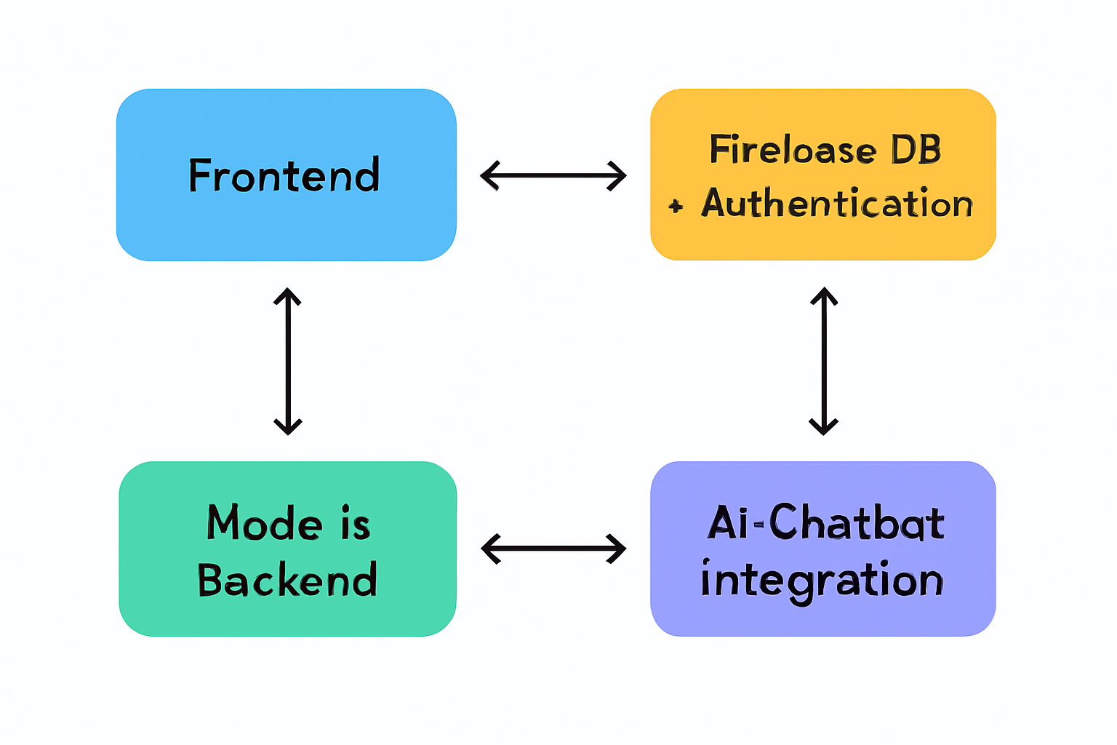
Tech Stack
System Architecture
Title: Technology Used
Frontend:
HTML5, CSS3, JavaScript, React.js
Backend:
Node.js (Express.js)
Firebase (Authentication & Database)
Other Integrations:
AI Chatbot for live support
AREA roles for accessibility
Responsive Design (mobile-first)

Slide 6
Target User
01
02
03
Primary Target
Users
Secondary Target Users
Other Users
Individuals with Cognitive Disabilities, Neurodivergent Users, Users who may not be formally diagnosed but prefer or require low-stimulation, highly structured digital interfaces.
Parents & Caregivers, Special Educators and Therapists, Nonprofits & Accessibility Advocates
Educational Institutions, Government & Public Service Platforms, Mental Health Support Groups, UX Designers and Accessibility Researchers, International Aid and Relief Organizations

Slide 7




Competitive Analysis
Our Competitors are LearningRx, Brighton Center, Easterseals, NIEPID, World Disability Union and some small companies provides the different services for cognitive disable persons.
Key Features - Adaptive Step Progression, Visual Cue Highlighting, Context-Aware Help Trigger, Integrated Chatbot Support, Multimodal Guidance, Progress Tracking Bar, Instant Replay Option, Distraction-Free Mode, Feedback & Reinforcement, Language Simplification Engine.
Prihub taps into the $3–4B global cognitive accessibility market through freemium services, institutional licensing, NGO/government funding, and strategic partnerships—targeting a ₹25–50 crore annual revenue opportunity across regions like India, US, Europe, and Southeast Asia.
Prihub uniquely combines assistive AI, visual walkthroughs, and end-to-end full-stack design focused entirely on cognitive disability accessibility.

Slide 8
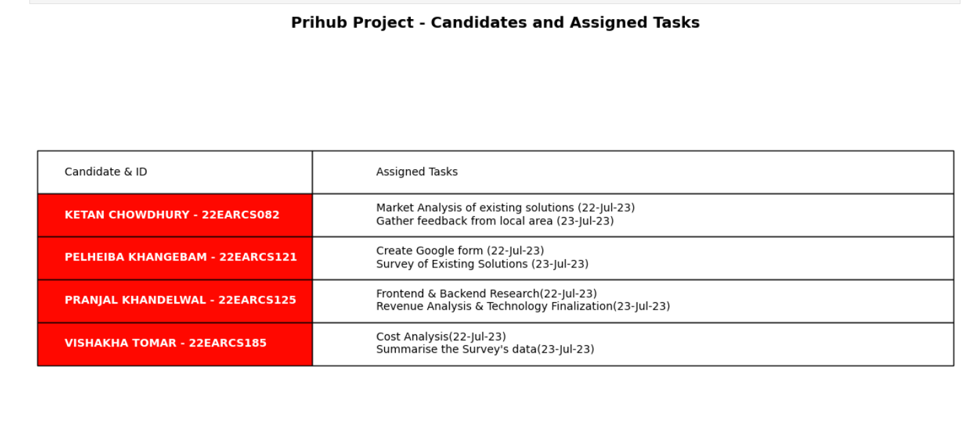
Working of Team

Slide 9
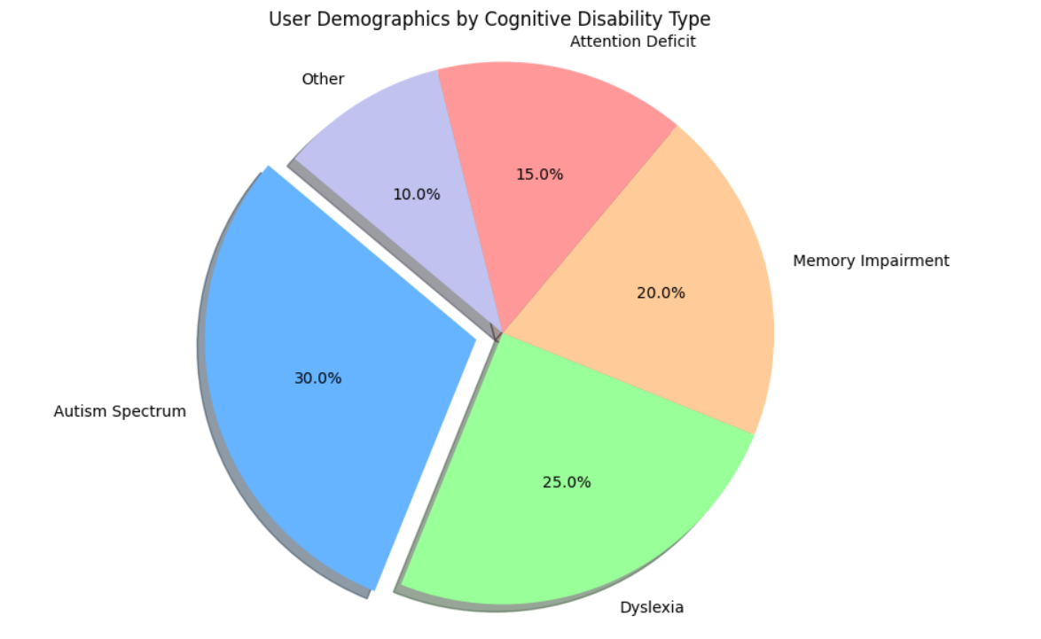
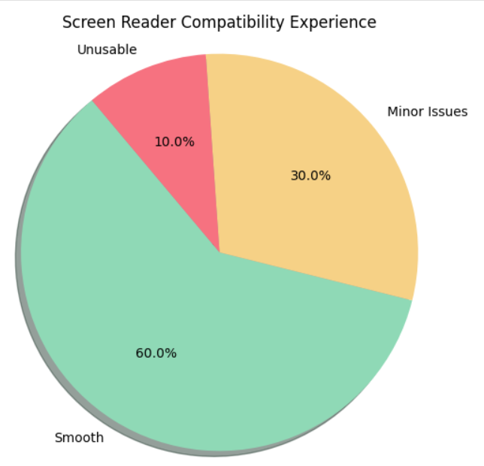
Survey Analysis
User Response analysis

Slide 10
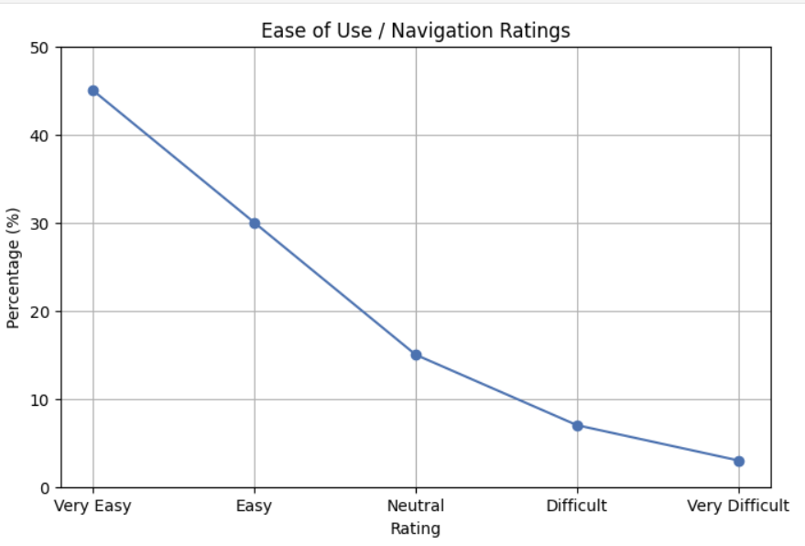
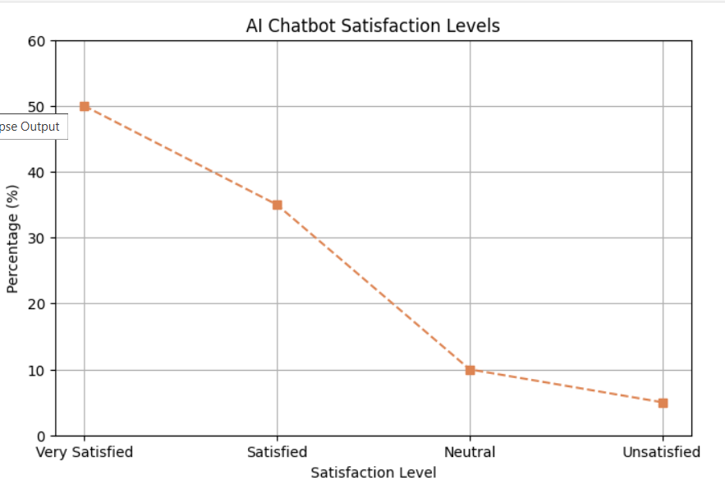

Slide 11
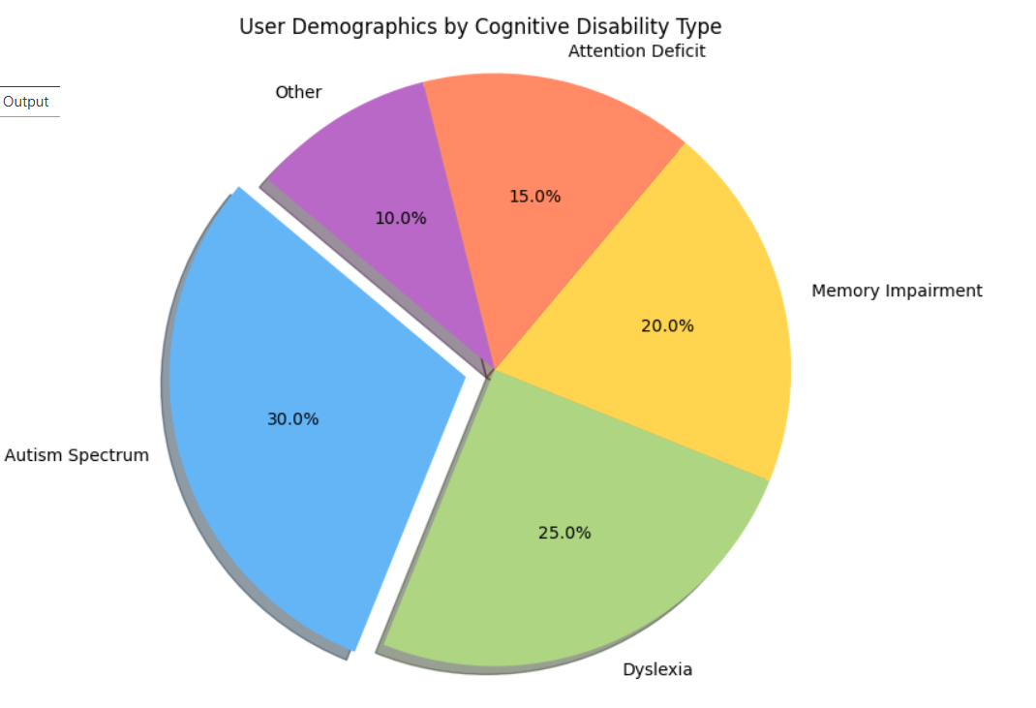
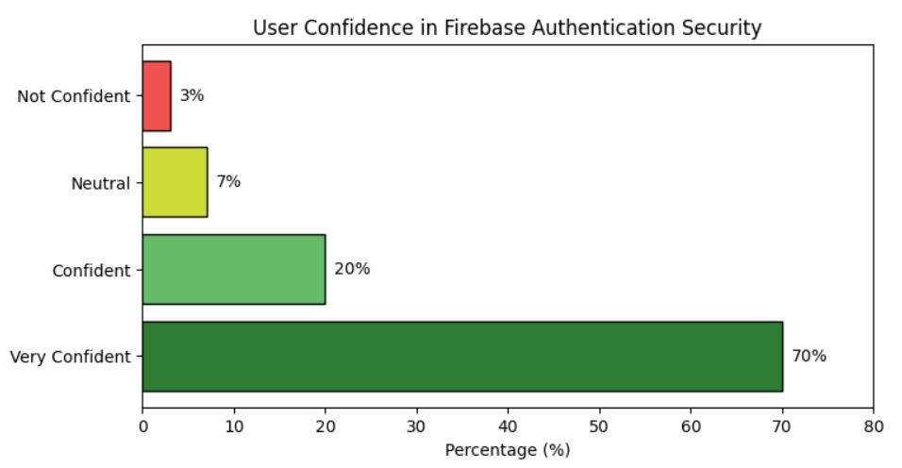

Slide 12
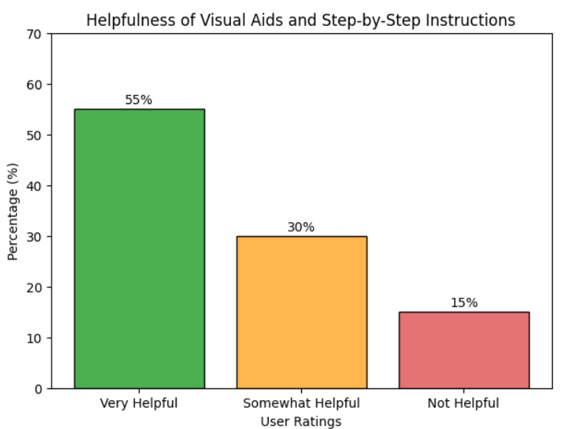
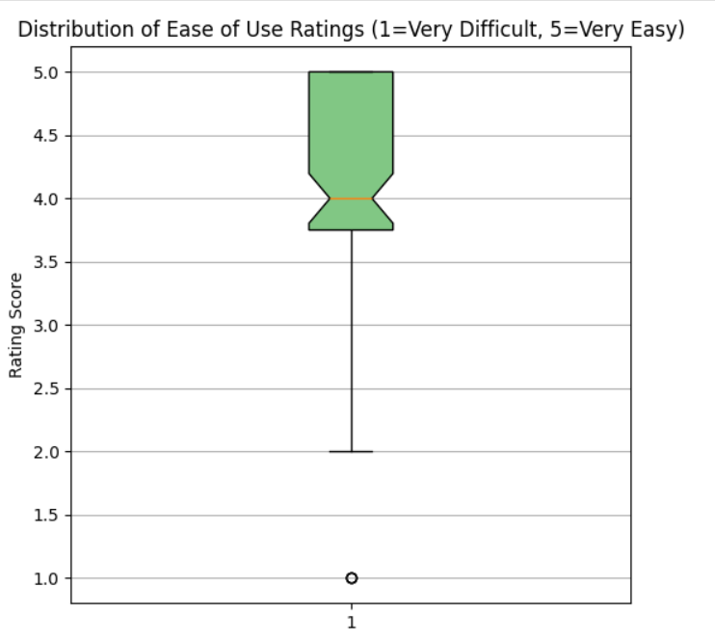
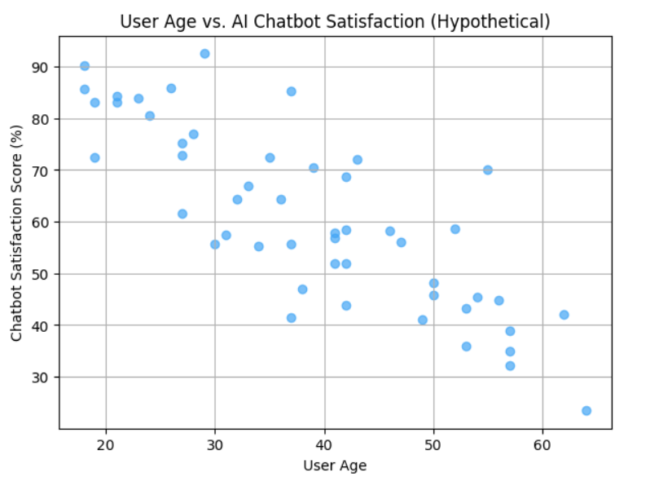

Slide 13
Revenue Model
Subscription Plans: Prihub offers tiered subscription plans with increasing features and support levels—from a low-cost basic access tier encouraging community contributions, to enhanced support and premium personalized tiers including caregiver/family plans. This provides stable recurring revenue while keeping the platform affordable and accessible.
Value-Added Services: Certain advanced AI chatbot services or specialized content modules are billed based on usage via "Contextual Clarity Units," which charge users proportionally to how much complex information is simplified for them. This keeps pricing transparent and aligned with delivered value.
Institutional Licensing: Prihub partners with schools, care centers, and therapy organizations by offering bulk or customized licenses bundled with staff training and anonymized insights to improve institutional support, generating revenue trough B2B sales beyond individual users.
Donations and Grants: Leveraging its social impact mission, Prihub invites philanthropic donations and grant funding, including sponsor programs for subsidizing access to users in need, supplementing revenue and advancing accessibility goals.

Slide 14
Financial Assessment
Revenue Source | Calculation | Amount (₹) | % of Total Revenue
Service Charges (Gross) | 1,000 × ₹400 | 4,00,000 | 100%
Vendor Registration Fee | 100 × ₹500 | 50,000 | 12.5%
Training Fee | 20 vendors × ₹1,500 | 30,000 | 7.5%
Commission (12% of service revenue) | 12% × ₹4,00,000 | 48,000 | 12%
Lead Generation Credits (10 vendors) | 10 × ₹2,000 | 20,000 | 5%
Advertising (8% of service revenue) | 8% × ₹4,00,000 | 32,000 | 8%
Cancellation Fees (8% of cancelled requests) | 5% cancellations × 1,000 × ₹400 × 8% | 1,600 | 0.4%
Total Estimated Revenue |  | 6,81,600 | 170.4% of base svc.
Assumptions:
Monthly service requests: 1,000
Average cost per service request: ₹400
Total monthly revenue from services: ₹4,00,000 (1,000 × ₹400)
Number of vendors: 100
Vendor registration fee: ₹500 per vendor
Training fee (assumed 20% vendors need training): ₹1,500 each
Commission rate on services: average 12%
Lead generation credits: 10% vendors subscribe, paying ₹2,000 per month
Advertising revenue: estimated at 8% of total service revenue
Cancellation fee: 8% of cancelled requests (assume 5% cancellation rate)

Slide 15
Expense | Amount (₹ per month)
Development & Hosting (e.g., Firebase, Node.js backend) | 12,000
AI Chatbot & API Integration | 8,000
Marketing & SEO | 5,000
Platform Maintenance & Updates | 4,000
Miscellaneous (App deployment, licenses) | 2,000
Total Monthly Cost | 31,000
Net Profit Estimate:
Net Profit = Total Revenue − Total Cost = ₹6,81,600 − ₹31,000 = ₹6,50,600

Slide 16




Future Roadmap
Our next step is to scale Prihub's accessible platform nationwide, aiming to onboard 10,000 users in 12 months, and we seek ₹80 lakhs in investor support to fund enhanced AI development, broader outreach, institutional partnerships, Multilingual support, Integration with telehealth services, Personalized dashboards, Community forum integration and Offline support via PWA
Prototype
Launch
V2.0
V2.2
Q3 2025
Q4 2026
Q1 2027
Q1 2027

Slide 17

Thank You
FOR YOUR TIME
Supported by - Arya Incubation Cell
Arya College of IT & Engineering

